Slide 1
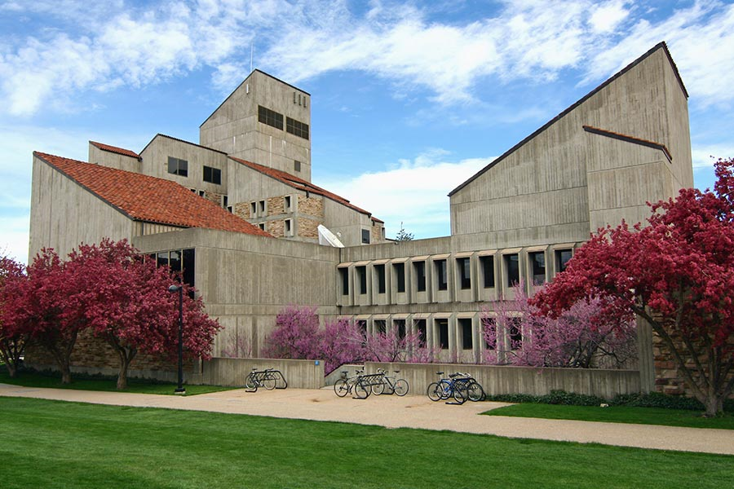
Ocean’s Seven
CU
Logo
Ocean’s 7
Logo
Names, alphabetical by last name
Sponsored By: CU Robotics Club, With help from: Christopher ‘Topher’ Pollard? Jeff? Others?
Controls 1
Requirements or Hardware?
Blurb About What We Are Doing and Why
Maybe Sub Image?
Power 1
Requirements/Hardware
Controls 2
Supporting Information
Approximately 2’x2’
Software
.5’x1’
Power 2
Supporting Information
Approximately 2’x2’
Backplane
Snakes on a back plane?
.5’x1’

